Slide 1
Technical Deep Dive: Creating Apps for the Intelligent Cloud Day1 – Architecting for Scale
<Presenter Name>

Slide 2
Agenda
Scalability & Architecting for Scale
Caching Data
Scaling Globally with Traffic Manager
Azure CDN

Slide 3
Scalability

Slide 4
What is Scalability
Scalability is the ability to add additional capacity to the service to handle increases in load and demand, together with efficient and effective use of resources allocated
Users (amount of work)
Response Time (accommodate the growth)

Slide 5
Architecting for Scale

Slide 6
Scalability Inhibitors
CPU and Memory of Web Servers
Application Designs that are not Stateless
Database/Storage Dependency
Network Latency and Bandwidth Limits

Slide 7
Database Bottleneck
Web Server
Site (W3WP.EXE)
Web Server
Site (W3WP.EXE)
Load Balancer
Web Site Database
Web Server
Site (W3WP.EXE)

Slide 8
Mitigate Database Bottleneck
Web Server
Web Site Database
Shard #1
Site (W3WP.EXE)
Web Server
Site (W3WP.EXE)
Web Site Database
Shard #2
Load Balancer
Web Server
Site (W3WP.EXE)
Web Site Database
Shared #3

Slide 9
Reducing Further Database Load - Caching
Data Tier
Cache
Web Server
Site (W3WP.EXE)
Web Server
IIS ARR (LB)
Site (W3WP.EXE)
Web Server
Site (W3WP.EXE)
Disable session affinity.
Use cache such as Redis for reference data and user session data to reduce load on the database even further

Slide 10

Background processing decoupling
Worker
Worker process
request queue
Web Server
Site (W3WP.EXE)
Load Balancer
Web Site Database
response queue

Slide 11
Background processing decoupling & scaling
Worker
Web Server
Worker process
Site (W3WP.EXE)
request queue
Web Server
Site (W3WP.EXE)
Load Balancer
Web Site Database
response queue
Web Server
Worker
Site (W3WP.EXE)
Worker process

Slide 12
Scalability Enablers
Increasing Compute On-Demand (AutoScale)
Microservices approach
Caching Data (Redis Cache)
Routing Users to Closest Datacenter (Traffic Manager)
Leveraging Asynchronous APIs

Slide 13
Scaling Compute

Slide 14
Compute Scaling Options (Azure App Service)
Scale Up (vertical)
Small to Large Instance Sizes
*) max 8 cores/14GB P4 Plan
Scale Out (horizontal)
Add Additional Instances
Basic Plan: Up to 3 Dedicated Instances
Standard Plan: Up to 10 Dedicated Instances
Premium Plan: Up to 20 or 50 (ASE) Dedicated Instances
LARGE
4 CORES
7 GB MEMORY
50 GB STORAGE
MEDIUM
2 CORES
3.5 GB MEMORY
10 GB STORAGE
SMALL
1 CORE
1.75 GB MEMORY
1 GB STORAGE
http://azure.microsoft.com/en-us/pricing/details/app-service/plans/

Slide 15
Compute Scaling Options (Web Roles)
Scale Up (vertical)
D-series (60% faster)
Max. 16 cores 112GB RAM, 800GB SSD (D14)
A-Series
Max. 16 cores 112 GB RAM Intel Xeon 2.5GHz (A11)
Scale Out (horizontal)
Add Additional Instances
Default 20 core quota per subscription – max. 50 VM instances

Slide 16
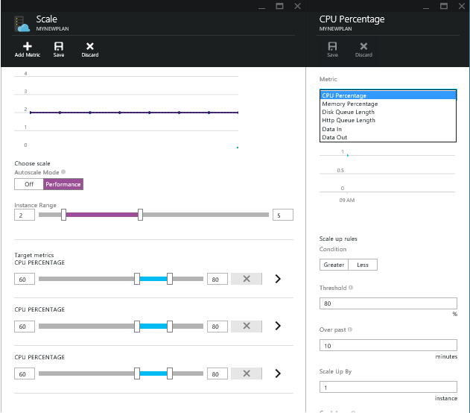
Auto-scaling Compute
Metric based
Time based
Storage Queue based
( Web/Worker Roles)
Multiple rules allowed
System must be designed for horizontal scalability
No process affinity
Must be stateless

Slide 17
Scaling Azure SQL Database

Slide 18
Scaling Azure SQL Database
Scale Up (vertical)
Add more resources to the database node
Scale Out (horizontal)
Partition data to host on multiple nodes.
Shard mgr
Premium
Standard
Shard1
Shard2
Shard 3
Basic

Slide 19
Azure SQL Database Scale Up - limits
DTU -relative capacity of a performance level based on a blended measure of CPU, memory, and read and write rates offered by each performance level. Doubling the DTU rating of a database equates to doubling the database power.
Service Tier | DTU | Max DB Size (GB) | Max Concurrent Req | Max Sessions | Benchmark Transaction Rate | Predictability
Basic | 5 | 2 | 30 | 300 | 16600 Transactions/Hour | Good
Standard/S0 | 10 | 250 | 60 | 600 | 521 Transactions/Minute | Better
Standard/S1 | 20 | 250 | 90 | 900 | 934 Transactions/Minute | Better
Standard/S2 | 50 | 250 | 120 | 1200 | 2570 Transactions/Minute | Better
Standard/S3 | 100 | 250 | 200 | 2400 | 5100 Transactions/Minute | Better
Premium/P1 | 125 | 500 | 200 | 2400 | 105 Transactions/Second | Best
Premium/P2 | 250 | 500 | 400 | 4800 | 228 Transactions/Second | Best
Premium/P3 | 1000 | 500 | 1600 | 19200 | 735 Transactions/Second | Best

Slide 20

Azure SQL Database Active Geo-Replication
Available in Premium Tier
Multiple read-only secondary's (max 4)
Application uses secondary's for read only workloads
r/o Replica 1
Application
r/w Primary
r/o Replica 4

Slide 21
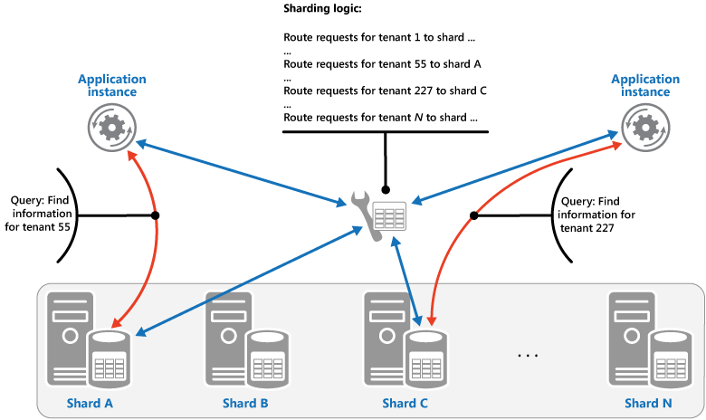
Sharding Pattern
Divide a data store into a set of horizontal partitions or shards. This pattern can improve scalability when storing and accessing large volumes of data.

Slide 22




SQL Azure Scaling Out
Shard Map Manager and Shard DBs
Data-dependent routing
Multi-shard querying
Elastic database pool
Key | Shard
1 | Server 1, DB A
2 | Server 1, DB A
3 | Server 1, DB A
4 | Server 1, DB A
DB A
DB B
List Map
Shard Map
Manager
Application
Application
Developer
Key Range | Shard
100-500 | Server 2, DB C
500-1000 | Server 2, DB D
1000-1500 | Server 3, DB E
1500-2000 | Server 4, DB F
DB C
DB E
DB D
Range Map
DB F

Slide 23
Demo

Slide 24
Tenancy models for SaaS Apps
Single-tenant per database
Single tenant per database
Each tenant’s data is stored in a different database
Better isolation of tenants as compared to multi-tenant model
Multiple tenants per database
Multiple tenants share the same database
Less isolation of tenants as compared to single tenant model
Typically more cost-effective than the single tenant model
Hybrid model
Some tenants share databases, others get their own database
E.g., premium or paying customers get their own databases, while free tier customers share databases
DB₁
DB₂
Customer 1
Customer 2
…
Multi-tenant per database
DB₁
DB₂
Customer 1
Customer 4
…
Customer 2
Customer 5
Customer 3
Customer 6

Slide 25


Azure SQL Database Auto-scaling
via Powershell
automate with Azure Automation
Azure Automation (SE)
Set-AzureSqlDatabase $ctx $db -MaxSizeGB 50
-ServiceObjective $serviceObjective
-Force
Admin/
DevOps
Vertical scaling
DB₆
_{[500-600)}
DB₅
_{[400-500)}
DB₄
_{[300-400)}
Horizontal scaling
DB₁
_{[0-100)}
DB₂
_{[100-200)}
DB₃
_{[200-300)}
DB_{n}
_{[n-n+100)}
. . .
S0
S0
S0
S2
P1
P3
time

Slide 26
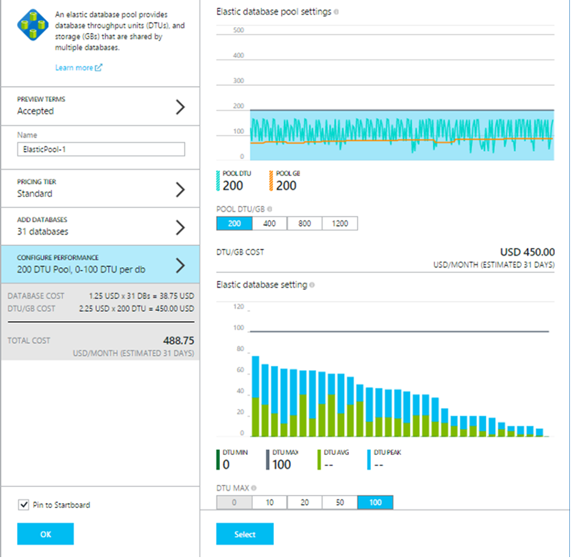
Azure Elastic Database Pool
Azure manages DTU assignment
Set min/max DTU per database
Add remove databases from pool

Slide 27
Caching Data

Slide 28
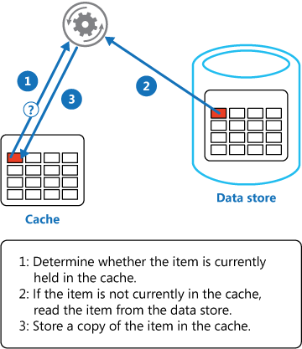
Cache-Aside Pattern
Load data on demand into a cache from a data store. This pattern can improve performance and also helps to maintain consistency between data held in the cache and the data in the underlying data store.

Slide 29
Azure Redis Cache
Available in 2 Tiers
Basic: Single Node Cache
Standard: Two-Node Primary/Secondary with automatic replication between the two nodes
Cache Sizes
250 MB, 1 GB, 2.8 GB, 6 GB, 13 GB, 26 GB, 53GB

Slide 30
Redis Cache
Redis Cache
Multi-tenant service managed service
Based on the open source Redis Cache
Key-Value store, where keys can be strings
or structures (hash, list, set, sorted set)
Support for Transactions, Pub/Sub, Limited TTL Keys
Memcached Cloud (Redis Labs)
Multi-tenant service managed by Redis Labs
Available in the Azure Store as an Add-On
// Simple cache-aside pattern
string value = cache.StringGet("key1");
if (value == null) {
value = GetValueFromDataSource();
cache.StringSet("key1", value);
}

Slide 31

Redis Cache Providers for ASP.Net Applications
ASP.Net Session State Provider
ASP.Net Page Output Cache Provider
Available via Nuget
Simple configuration in web.config

Slide 32
Session Break

Slide 33
Scaling Globally with Traffic Manager

Slide 34
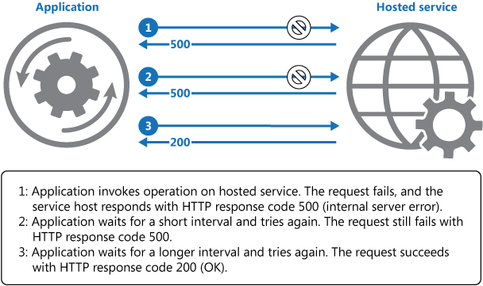
Retry Pattern
Enable an application to handle anticipated, temporary failures when it attempts to connect to a service or network resource by transparently retrying an operation that has previously failed in the expectation that the cause of the failure is transient. This pattern can improve the stability of the application.

Slide 35
Need for Global Scaling
Failures Happen
Protect your application by deploying in multiple regions
Get Closer to Your Customer
Lower latency = Happier Customers

Slide 36



How Traffic Manager Works
Map your domain name contoso.com -> contoso.trafficmanager.net
Map website URLs in one or more regions to your Traffic Manager Profile.
contosoeast.azurewebsites.net
contosowest.azurewebsites.net
Choose the Right Load Balancing Algorithm
Performance, Round Robin or Fail Over
www.contoso.com IN CNAME contoso.trafficmanager.net
DNS
Select endpoint
contosoeast.azurewebsites.net
contosowest.azurewebsites.net

Slide 37
Performance Profile
Traffic Manager determines fastest route for the client and returns IP for the appropriate website.
Location Portland, OR
contosotm.trafficmanager.net
Request for contoso.com
Response with IP for contosowest.azurewebsites.net
Traffic Manager Calculates Hops…
Health Probes
contosowest.azurewebsites.net
contosoeast.azurewebsites.net
Website
Website
INSTANCE1
INSTANCE2
INSTANCE1
INSTANCE2
West US
East US

Slide 38
Round Robin Profile
Traffic Manager returns IPs in a round robin fashion regardless of client location.
Location Portland, OR
contosotm.trafficmanager.net
Request for contoso.com
Traffic Manager Returns the Next IP
Could be West or East
Response with IP for contosoeast.azurewebsites.net
Health Probes
contosowest.azurewebsites.net
contosoeast.azurewebsites.net
Website
Website
INSTANCE1
INSTANCE2
INSTANCE1
INSTANCE2
West US
East US

Slide 39
Failover Profile
Traffic Manager always returns the IP address of the primary website unless it fails a health check.
ALL Requests
contosotm.trafficmanager.net
ALL Requests
Request for contoso.com
Request for contoso.com
Response with IP for contosowest.azurewebsites.net
Response with IP for contosoeast.azurewebsites.net
Health Probes
contosowest.azurewebsites.net
contosoeast.azurewebsites.net
X
Website
Website
INSTANCE1
INSTANCE2
INSTANCE1
INSTANCE2
West US
East US

Slide 40
Azure Content Delivery Network (CDN)

Slide 41
How CDN Works?
content from “origin” delivered via edge (POP) servers
static content / dynamic content
Webhost (origin)
Visitor
Visitors
Edge locations/POPs
Visitors

Slide 42
Azure CDN POP Locations
Azure CDN peers with 2,000+ Internet Service Providers (ISPs) to deliver rich content globally
42,000+ networks as of 2012
Over 30 points-of-presence (POPS) aka Edge locations
29 massive capacity POPs globally
http://msdn.microsoft.com/library/azure/gg680302.aspx

Slide 43
Azure CDN Static content caching on Edge servers
Traverse from London to West US - More Hops
http://mystorage.blob.core.windows.net/imgs/splash.png
Blob Storage
(West US)
Requested File
User (London, UK)
http://az590680.vo.msecnd.net/imgs/splash.png
Resolved to closest edge endpoint (Less Hops)
CDN Endpoint
(London Europe)
Reduced Latency

Slide 44
Managing Azure CDN Content Expiration
Default behavior is to fetch once and cache for up to 7 days
Modify max-age cache control blob header to control the TTL
x-ms-blob-cache-control: public, max-age=<value in seconds>
Think hours, days or weeks
Higher numbers reduce cost and latency via CDN, proxy & browser caches
Use versioned URLs to expire content on-demand
HTML Served by App
CDN
Blob Storage
… <img src="http://azXXXX.vo.msecnd.net/images/logo.2010-08-01.png" />…
… <img src="http://azXXXX.vo.msecnd.net/images/logo.2010-10-29.png" />…
logo.2010-08-01.png
logo.2010-08-01.png
logo.2010-10-29.png
logo.2010-10-29.png

Slide 45
Azure CDN Features
Roadmap features
Current features
Roadmap features
Current features
Access to content on Azure Storage or cloud service
Access to content on Azure Storage or cloud service
Content purging
Content purging
Country filtering
Access cached content over HTTPS using shared SSL certificate
Country filtering
Access cached content over HTTPS using shared SSL certificate
Advanced reporting
Advanced reporting
Query strings to differentiate objects retrieved from an origin
Query strings to differentiate objects retrieved from an origin
Advanced analytics
Advanced analytics
Utilize custom domain names
Utilize custom domain names
Load balancing
Load balancing
Enterprise-class billing, support, and management
Enterprise-class billing, support, and management
Token authentication
Token authentication
Single-screen billing, provisioning, and monitoring
Single-screen billing, provisioning, and monitoring
Media services integration
Media services integration

Slide 46
Case Study

Slide 47


OSIsoft-Global leader in operational intelligence speeds innovation with the Microsoft cloud platform
Overview
Partner: OSIsoft
Partner Website: www.osisoft.com
Partner Size: 1135 employees
Country or Region: Global
Industry: Professional services—Software engineering
“The facilities for shared keys, caches, code, tables, and other components within Service Fabric allow us to do what we need to do without having to write tons and tons of very complicated code.”
Richard Beeson, CTO OSIsoft
Solution
The company is basing its cloud offerings on Microsoft Azure, using the Microsoft Azure Service Fabric platform and Visual Studio Online.
www.osisoft.com is using the Service Fabric platform to enhance its offerings for next generation scalability needs of its customers
Implementing on the Service Fabric platform in Microsoft Azure, OSIsoft was able to realize faster time-to-market and simplified Application Lifecycle Management (ALM) for massively scalable services.
Benefits
Exponential scalability
Streamlined development
Expanded data support
Strong hybrid cloud support
Simplified ALM
https://customers.microsoft.com/Pages/CustomerStory.aspx?recid=20391

Slide 48

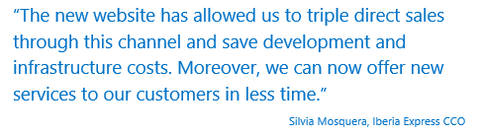
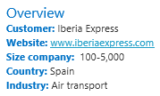

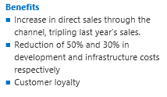
Iberia Express triples direct sales through website with Microsoft Azure
www.iberiaexpress.com architected for the cloud
used VSO as ALM for dev&test, pre- and production environments
Leverages services such as Azure Web Role with auto-scaling, Azure CDN, Azure Storage and Azure SQL Database with geo-replication and Azure virtual networks for backend integration
https://customers.microsoft.com/Pages/CustomerStory.aspx?recid=20881

Slide 49

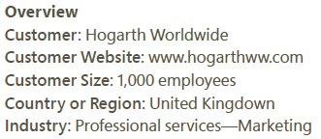
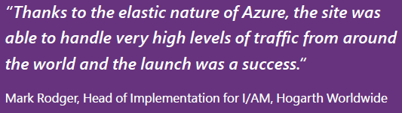
Marketing Agency Creates Revolutionary Digital Marketing Platform Using Cloud Solution
Situation:
Lack of centralized management to respond to market demand
Need to deliver web marketing experience at scale
Benefits:
Reduced Launch Time by Almost 60 Percent
Met High Demand with Scalability
Localized the Site Quickly
Made Real-Time Updates
created the Integrated Agile Marketing (I/AM) platform, which enables customers to run as many websites as they need
the platform is hosted in Azure and it publishes sites to Azure using Microsoft Azure Websites and Microsoft Azure SQL Database.
integrates with ZONZA, the company’s proprietary content management platform
https://customers.microsoft.com/Pages/CustomerStory.aspx?recid=16778

Slide 50
Video References
https://mva.microsoft.com/en-US/training-courses/build-always-on-hyper-scalable-microservice-based-cloud-services-13992?l=fqheWt4rB_1705368485
Episode 3 - Scalability and Deployment
Episode 7 - Design for Scalability
Surviving Success: Architecting Web Sites and Services for Rapid Growth
Building Big: Lessons Learned from Azure Customers

Slide 51
Scaling Guidance References
Scalability checklist
Autoscaling guidance
Data partitioning guidance
Caching guidance
Content Delivery Network (CDN) guidance

Slide 52
Contact Us Technical services to help you win more deals, accelerate deployment and increase consumption
Microsoft Azure
http://aka.ms/PartnerTechnicalServicesAzure
Microsoft CRM Online
http://aka.ms/PartnerTechnicalServicesCRMOnline
Microsoft Office 365
http://aka.ms/PartnerTechnicalServicesO365
Microsoft Windows 10 and Enterprise Mobility Suite
http://aka.ms/PartnerTechnicalServicesWin10EMS
Learn more about your technical support benefits
http://aka.ms/MySupport

